Slide 1
Data Safety in the Cloud
An Overview

Slide 2

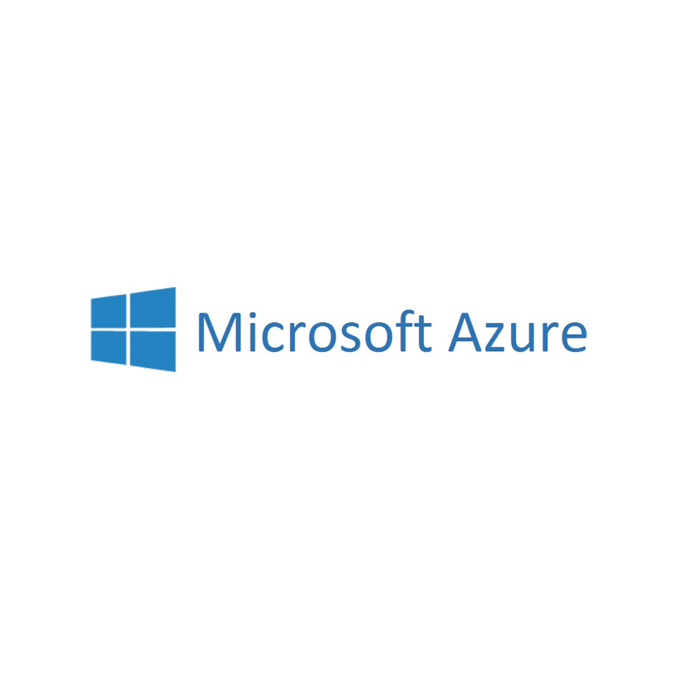

Introduction:
What is this Work About?
Businesses and individuals put growing amounts of data on the cloud
Cloud providers consolidate storage and computations
-> Easier management
-> Lower costs
Providers use commodity hardware to bring down costs
This Work:
Looks at product lineups of different providers
Looks at data safety mechanisms of providers

Slide 3
Key Concepts:
Safety and Security
Security:
Protection from malicious attackers
Make information inaccessible for unauthorized parties
Safety:
Protection from hardware failure
Protection from transmission errors
This work‘s topic: Data Safety

Slide 4
Key Concepts:
Durability and Availability
Availability:
Percentage of time the system is online
Typical values: 99% to 99.99%
Durability:
Metric for data safety
Percentage of objects retained over the period of one year
Typical values: ~99.999999999% (11-nines)

Slide 5
Key Concepts:
Backup and Redundancy
Backup:
Point-in-time copy of data
Used for recovery after catastrophic failure or deletion
Redundancy:
Copy of data continually kept up-to-date
Used as a failover in case of a site failure

Slide 6
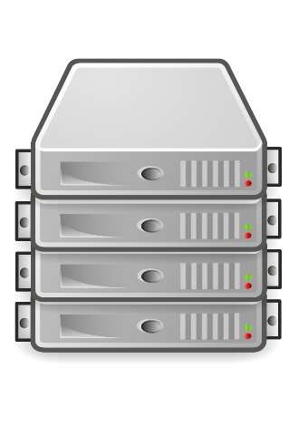
Key Concepts:
Redundancy
Data access only from one location
Replication to one or more other sites
Replication
Read/Write

Slide 7
Product Lineup:
Cold Object Storage
Usages:
Archiving
Disaster Recovery
Backups
Technologies:
Redundancy (local/zone/global)
Products:
Google Cloud Nearline
Google Cloud Coldline
Amazon S3 Infrequent Access
Amazon Glacier
Microsoft Backup

Slide 8
Product Lineup:
Data Warehouse & Big Data
Usages:
Business Analysis
Process Optimization
Technologies:
Automatic Backups
Local Redundancy
Products:
Google Bigtable
Microsoft SQL Data Warehouse
Amazon Redshift
Microsoft Data Lake

Slide 9
Product Lineup:
Globally Scaling Database
Usages:
Globally Distributed Applications
IoT
Mobile
Technologies:
Automatic Backups
Geo Redundancy
Products:
Google Cloud Spanner
Microsoft Cosmos DB

Slide 10
Product Lineup:
NoSQL Database
Usages:
Key-Value Storage
Low Latency
Technologies:
Manual Backups
Local or Geo-Redundancy
Products:
Microsoft Table Storage
Google Cloud Datastore
Amazon DynamoDB

Slide 11
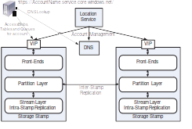
Technology:
Microsoft Azure Storage
Layered architecture with redundancies at every level
Following: Top-down overview of the system

Slide 12

Technology:
Microsoft Azure Storage
VIP (Virtual IP)
Entry-point to the stamp
Front-Ends
Authentication & Authorization
Routing to Partition Server
Partition Layer
Abstractions to data in Stream Layer
Object caching
Object-based inter-stamp replication
Stream Layer
Data storage
Intra-stamp Replication

Slide 13

Technology:
Microsoft Azure Storage
We are here!

Slide 14
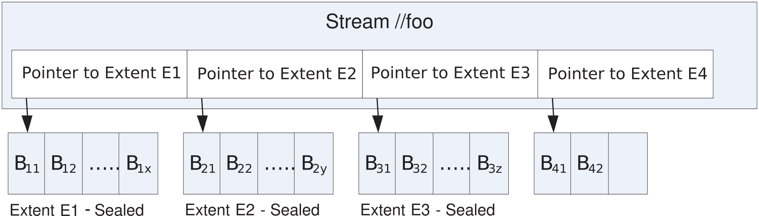
Technology:
Microsoft Azure Storage
Streams
Stream
Looks like traditional file to Partition Layer
Internally: Only pointers to extents
Append-only
Block
Smallest unit of data
Variable size
Extent
Sequence of Blocks
Append-only
Target size: 1GB
When full: Sealed

Slide 15
Implications:
What to Choose
The ideal solution for your program depends on its requirements:
Need safe storage?
→ Choose any solution with high levels of redundancy
Need to process lots of data?
→ Choose any big data or data warehouse solution
Need NoSQL storage?
→ Choose any NoSQL solution (but make regular backups)
Need global, consistent and fast access to your data?
→ Choose any globally spanning database
Need multiple things?
→ Combine your solutions e.g. have a safe storage for important data but copy it to a big data solution for processing

Slide 16
Implications:
How to design
General design guidelines:
Do not rely on locally mounted storage!
  Block storage is available but inflexible
  Use more flexible and safer storage options
Seperate storage functionality from the rest of the program
  Makes it easier to migrate data to a different provider later
  Makes it easier to adapt to provider API changes
Keep applications stateless
  Easily update application if provider or storage needs change

Slide 17
Conclusion:
Summing it all up
Providers offer products and services for almost every use-case
Providers invest heavily into their architectures and the technologies behind them
Data safety is achieved through several technologies:
  Erasure Coding & RAID
  Data Redundancy across one or more facilities
  Automatic Backups
The challenges providers are facing today are about maintaining strong consistency and high performance across a global database
Thank You For Listening

